Slide 1


Game of life
Workshop Odisee

Slide 2
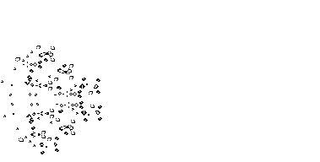
Game of life

Slide 3

Underpopulation
(< 2)

Slide 4
Overpopulation
(> 3)

Slide 5

Sustenance
(== 2 || == 3)

Slide 6

Reproduction
(== 3)

Slide 7

Assumptions
finite world
square world

Slide 8
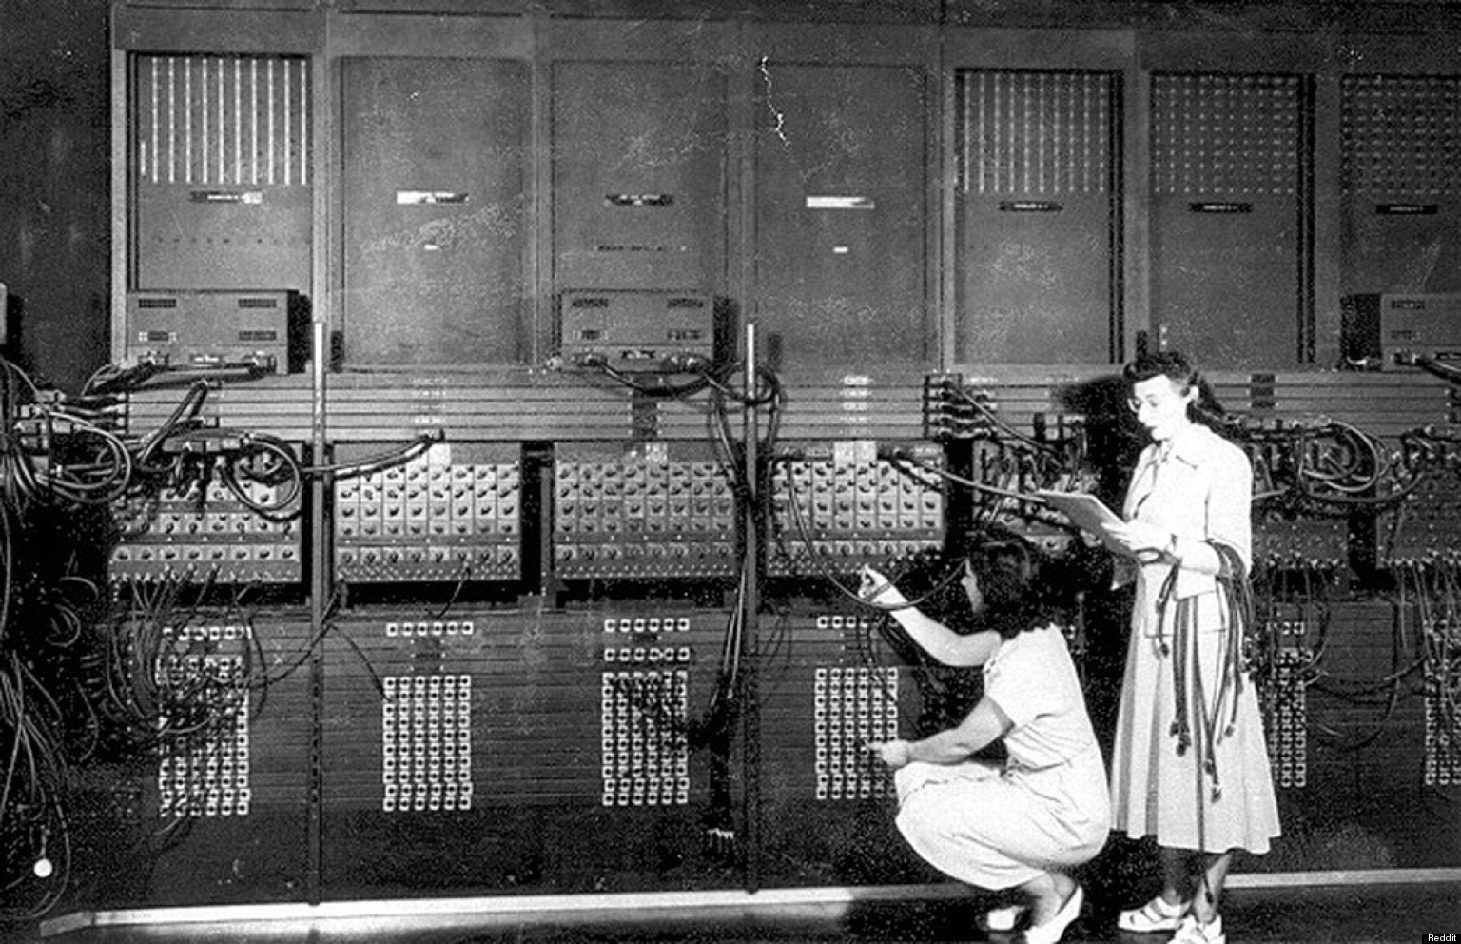
Pair programming

Slide 9
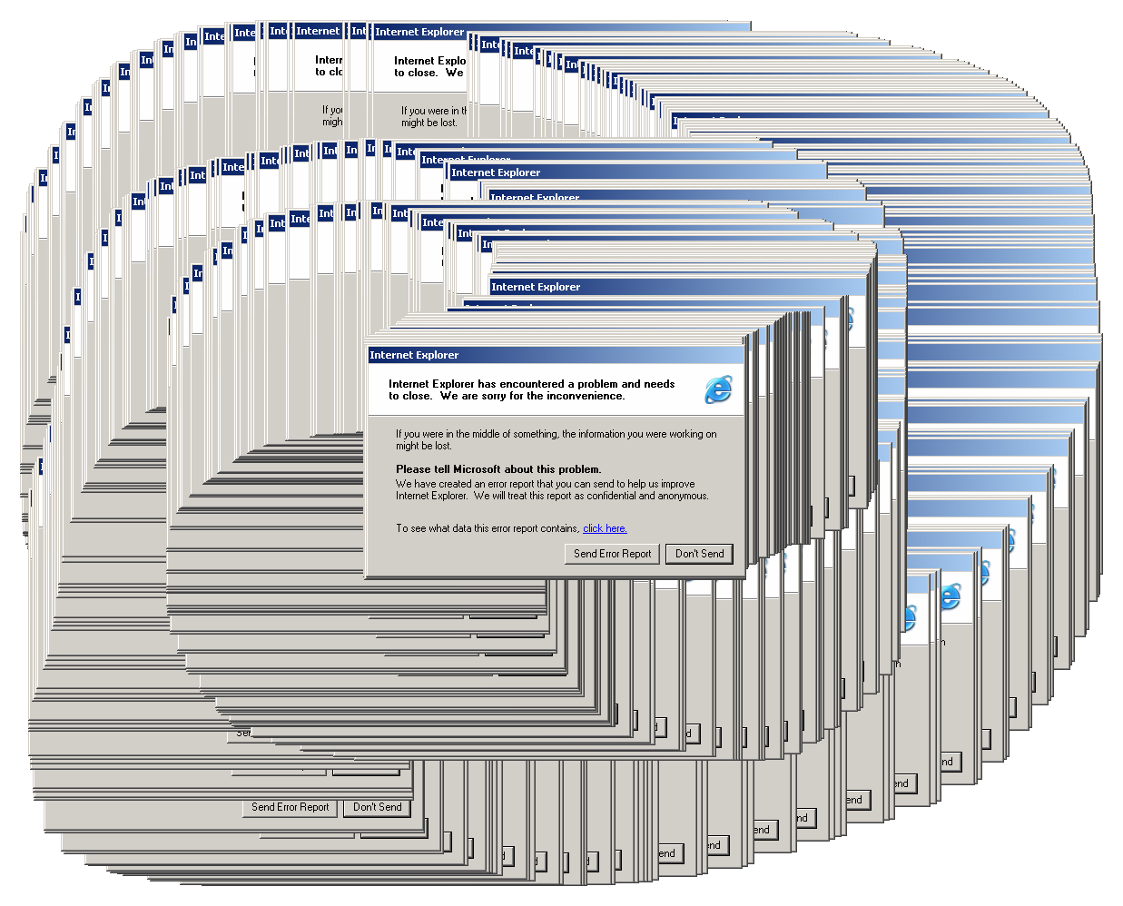
User interface

Slide 10

Tools
jdk 8 - git - IDE

Slide 11

Git
# git clone https://github.com/switchfully/gameoflife-kata.git
…do some coding…
# git add .
# git commit -m “{message}”

Slide 12

Run
*nix
# ./gradlew bootRun
windows
# gradlew bootRun

Slide 13


Slide 14

4 rules of
simple design
1. Passes all tests
2. Minimise duplication (of concepts)
3. Reveals intent / maximise clarity
4. Fewest elements

